Slide 1
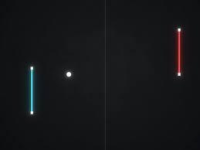

GAME OF PONG
Department of Information Technology
Galgotias College of Engineering and Technology Greater Noida
(Supervisor: Mr.Ranjeet Kumar )
BY MUKUL NAG 67
IT 3 A

Slide 2

Index
Introduction(scope of the work and its importance)
Hardware /Software Requirement
Design/Implementation
Testing/Result and Analysis
Conclusions & future enhancements
References

Slide 3


GAME FEATURES/Introduction:
The primary project is Pong, the design and development of which will be discussed in detail here. If you choose to submit an alternative project for this assignment then you must submit a proposal for you version of the project and you must ensure that the following in features are included:
game loop
game graphical display with sounds
user interaction through the keyboard
at least one animated object
collision detection for fixed and moving objects
score keeping
management of game start (restart) and game completion

Slide 4
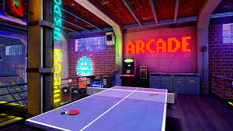
Game Concept
This game project will be an homage to the classic Pong. In the original version, a small pip (the ball) is hit left and right by "paddles" vertically moving paddles controlled by two players. The ball would bounce off the top and bottom of the display region. If the ball passed a player's paddle, a point would be added to the opponent's score. First to 11 won the game. The player winning the point would also win the serve which meant that the ball would appear in front of that player's paddle and move toward the opponents side of the display. The angle of deflection of the ball from the paddle could be controlled by the speed at which the paddle was moving when it hit the ball. The speed of the ball slowly increased during a volley, but would return to the initial slower speed at the beginning of the next server. Sounds included a blip for the paddle striking the ball, a sound for a missed return and an end of game sound.

Slide 5
Hardware /Software Requirement
CPU: Pentium III or Athlon equivalent
CPU SPEED: 1 Ghz
RAM: 256 MB
OS: Windows 2000/XP only
VIDEO CARD: 64 MB DirectX 8.1 compatible video card (NVIDIA GeForce 3 or better)
TOTAL VIDEO RAM: 64 MB
3D: Yes
PIXEL SHADER: 1.1
SOUND CARD: Yes
FREE DISK SPACE: 3.6 GB for minimal install
DVD-ROM: 8X DVD-ROM

Slide 6
Game Design
Pong Layout
Keys e and d
control vertical
motion of left
paddle
Keys l and o
control vertical
motion of right
paddle
ball out of play
paddle_left
left paddle position
plx, ply
paddle_right
right paddle position
prx, pry
ball object
ball position bx, by
ball velocity bvx, bvy

Slide 7
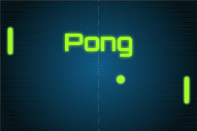
game loop
init variables
quit game
?
init game
new game
?
save old positiions
init game state
ball at top or
bottom
bounce ball
exit game
ball hits paddle
return ball
ball miss paddle
score & reset
update scoreboard
Implementation
Game Loop
players input
paddles at top
or bottom
stop paddle
animate
end loop

Slide 8
Checking Game Space Limits /Testing
(0,0)
?
if(padLeftY<padHeight/2)
padLeftY = padHeight/2;
if(padLeftY>SCREEN_H - padHeight/2)
padLeftY = SCREEN_H - padHeight/2;
if(padRightY<padHeight/2)
padRightY = padHeight/2;
if(padRightY>SCREEN_H - padHeight/2)
padRightY = SCREEN_H - padHeight/2;
padHeight
padLeftY
After player inputs have been handled the new positions of the movable objects need to be checked to ensure that they are within the game space limits. What to do to keep the objects inside the game space depends on the object's function. For the paddles, you can just replace the new position with the limiting position as if it has hit a boundary.

Slide 9
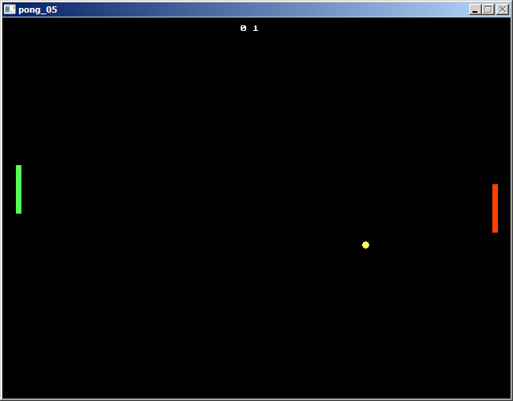
Conclusions

Slide 10
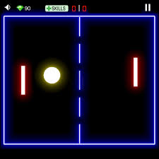
References
simplegui - Simplified GUI generation using Tkinter
Python manpages -https://www.python.org/
Codeskulpter -http://www.codeskulptor.org/docs.html#tabs-Python
Symplegui2python https://bitbucket.org/OPiMedia/

Slide 11
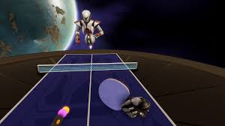
Thank You

